Slide 1

VULNERABILITY ANALYSIS
Dilsha Keerthi Kumara
12195171
COIT11241
Private Repository :https://github.com/DilshaWe/ePortfolio.git

Slide 2
What is a Vulnerability?
Intrinsic flaw built in
Often well-known
Can be exploited in some way
Notes:
A vulnerability refers to an intrinsic flaw built into the software or hardware of a device that is often well-known and can be exploited in some way.

Slide 3
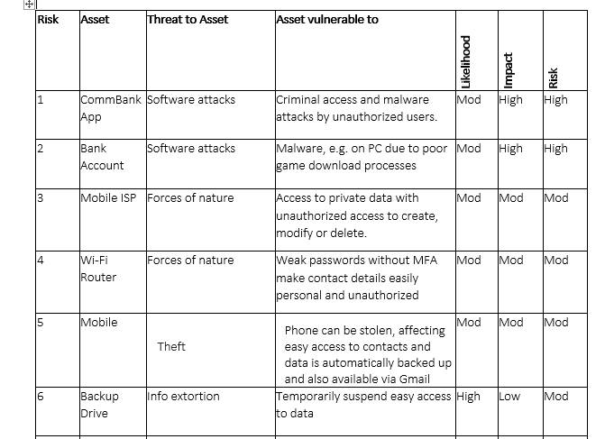
Recap Assignment 2

Slide 4
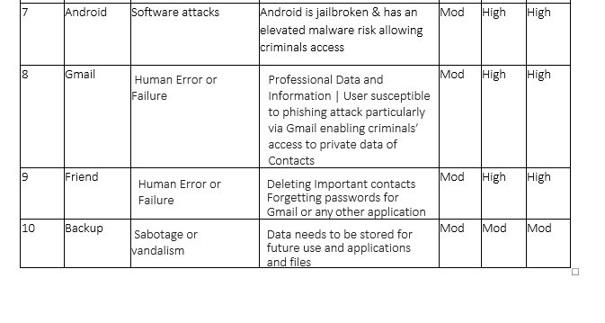
Recap Assignment 2

Slide 5
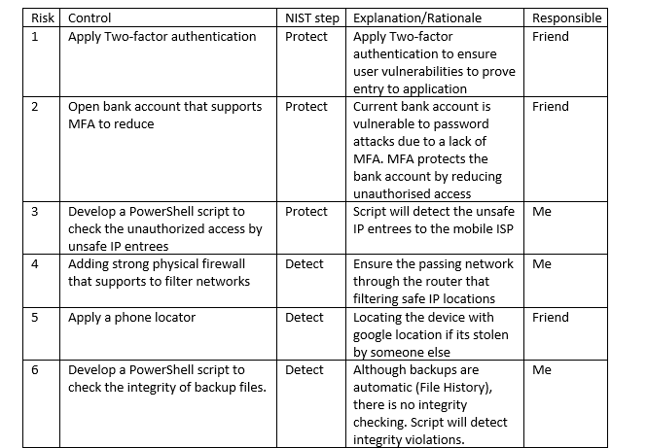
Recap Assignment 2

Slide 6
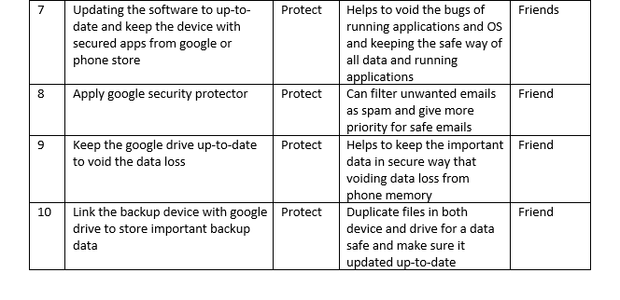
Recap Assignment 2

Slide 7

Nikto for Vulnerability scan of Metasploit VM machine

Slide 8
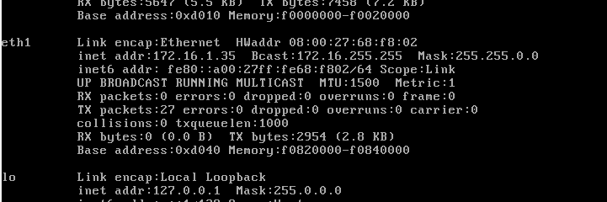
Check the IP address of Metasploit VM
Notes:
First I log in to the Metasploit VM and then log in to the Kali linux VM.
Then I checked the IP address of Metasploit

Slide 9
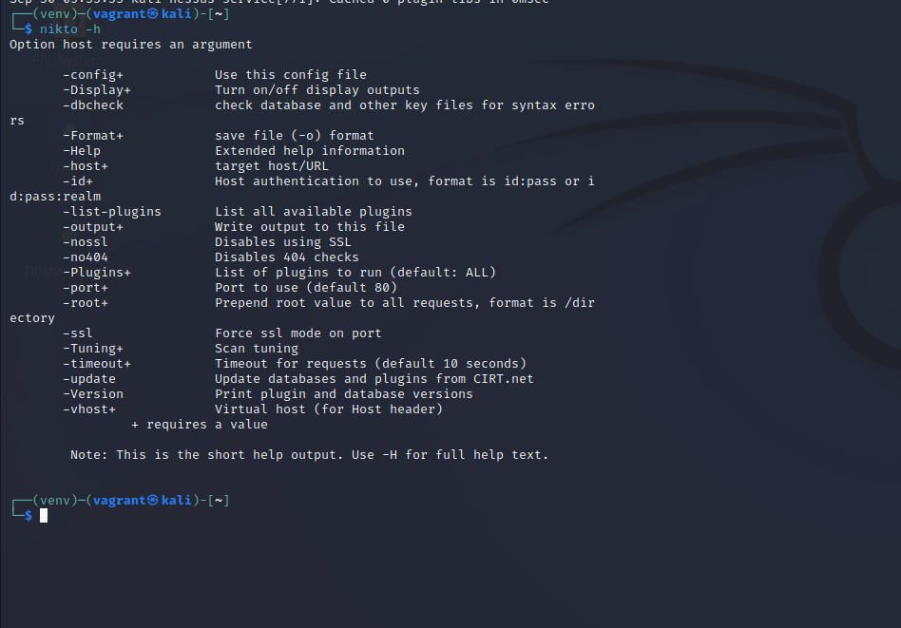
NIKTO in Kali linux and Metasploitable 2

Slide 10
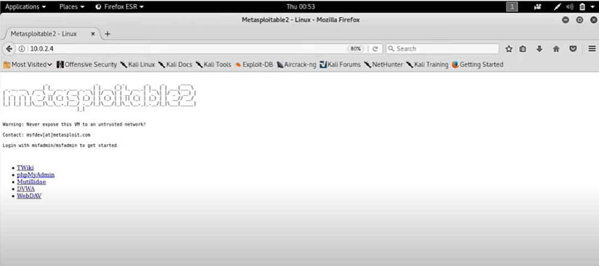
NIKTO in Kali linux and Metasploitable 2
Notes:
Then enter that ip address in the browser of kali linux.
After that I able to successfully log in to the Metasploit through the kali linux.

Slide 11
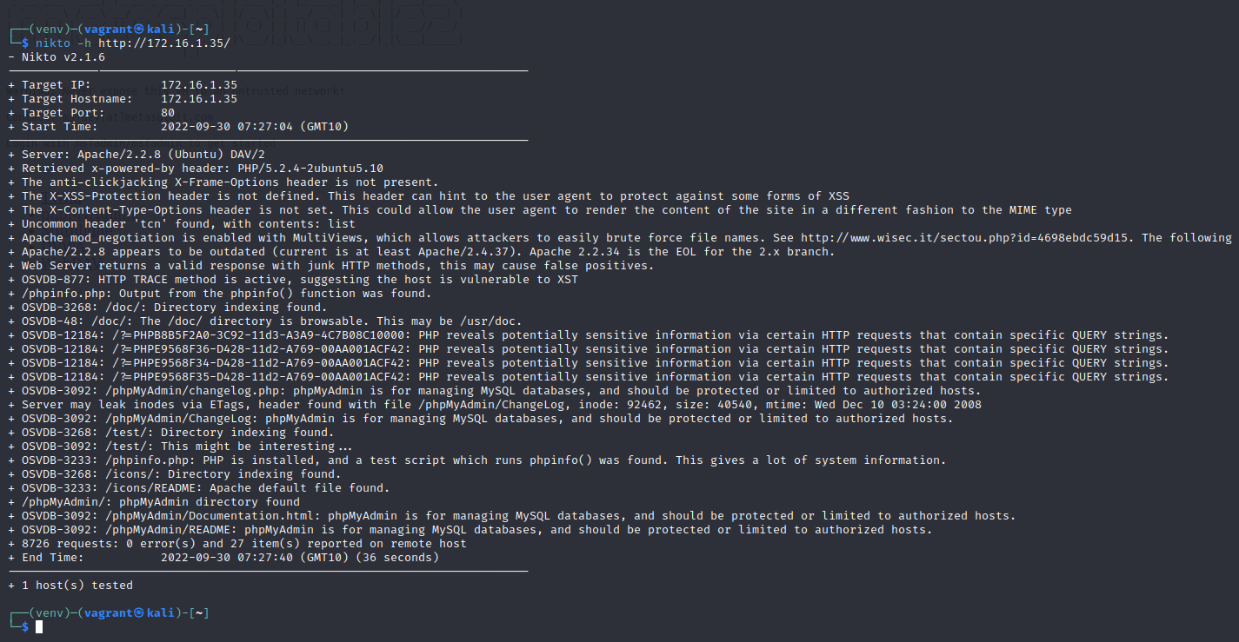

Slide 12
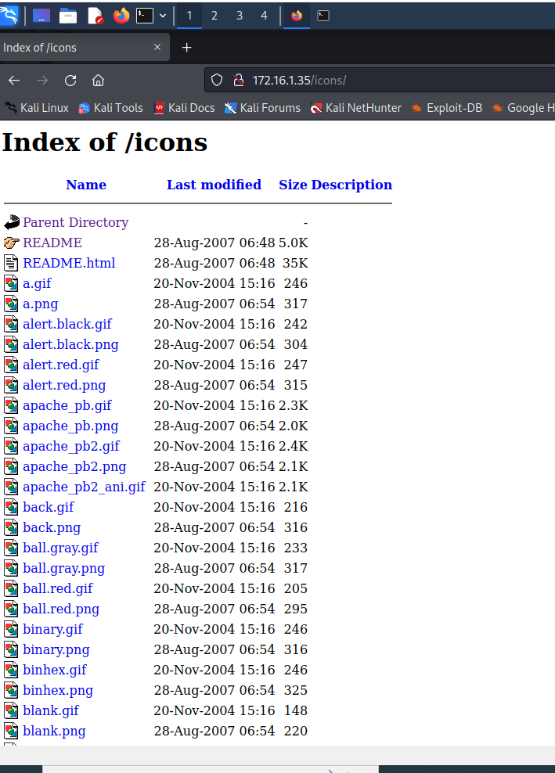
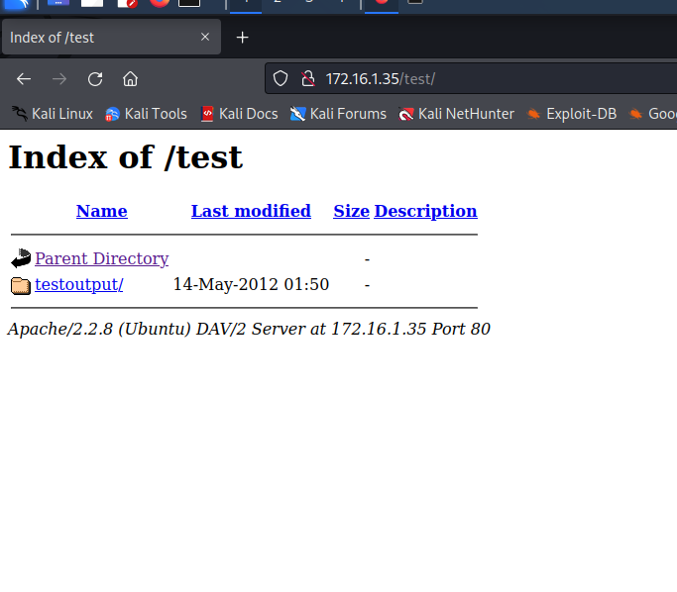

Slide 13
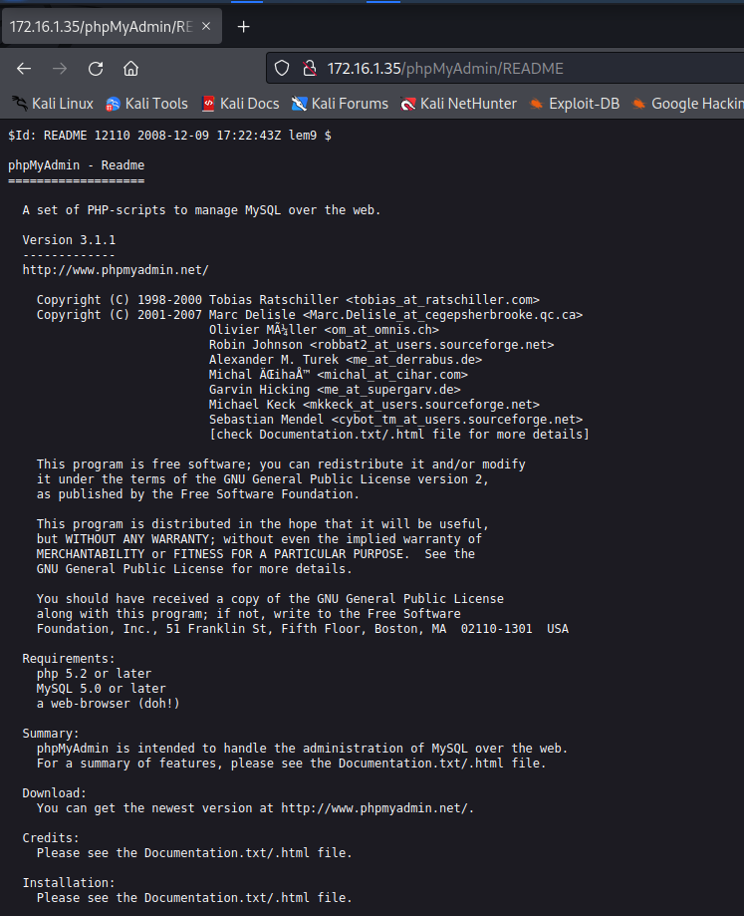

Slide 14
Scan victim machine with Nessus
Create a scan.
1
Select the Basic Network Scan for the home use edition.
2
Configure the Scan
3
Launch the Scan
4
Notes:
Create a scan. This can be done by clicking on My Scans and then on the New Scan button.
Upon clicking on the new scan, you will be presented with the different scan options provided by the Nessus. Note that most of the options are for the paid versions. We will be selecting the Basic Network Scan for the home use edition.
Launching message. This message box will disappear in a moment:
In this step, the user will be presented with the running message:
It will take between three and five minutes for the running icon to turn into a completed icon.

Slide 15
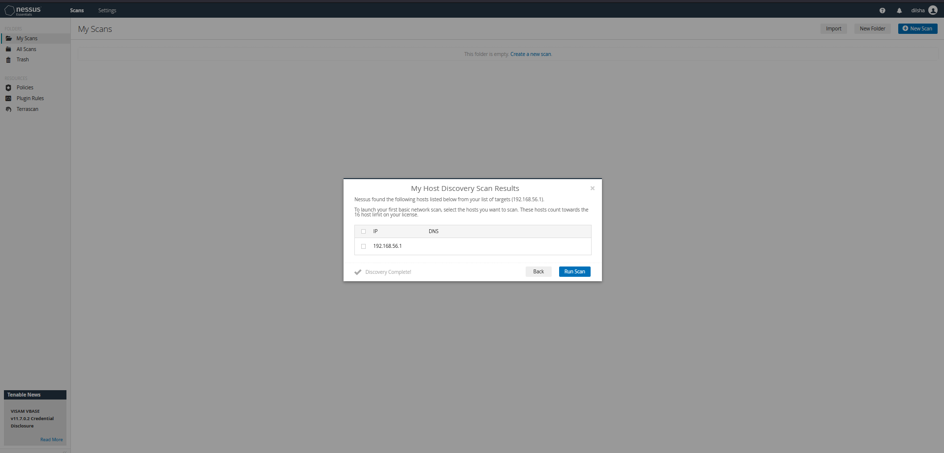
Vulnerability Scan of Windows 10 OS using Nessus

Slide 16
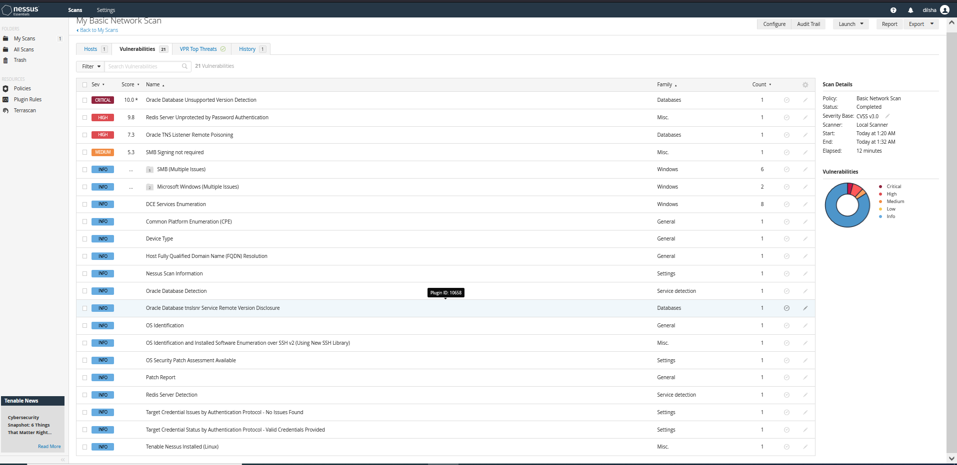

Slide 17
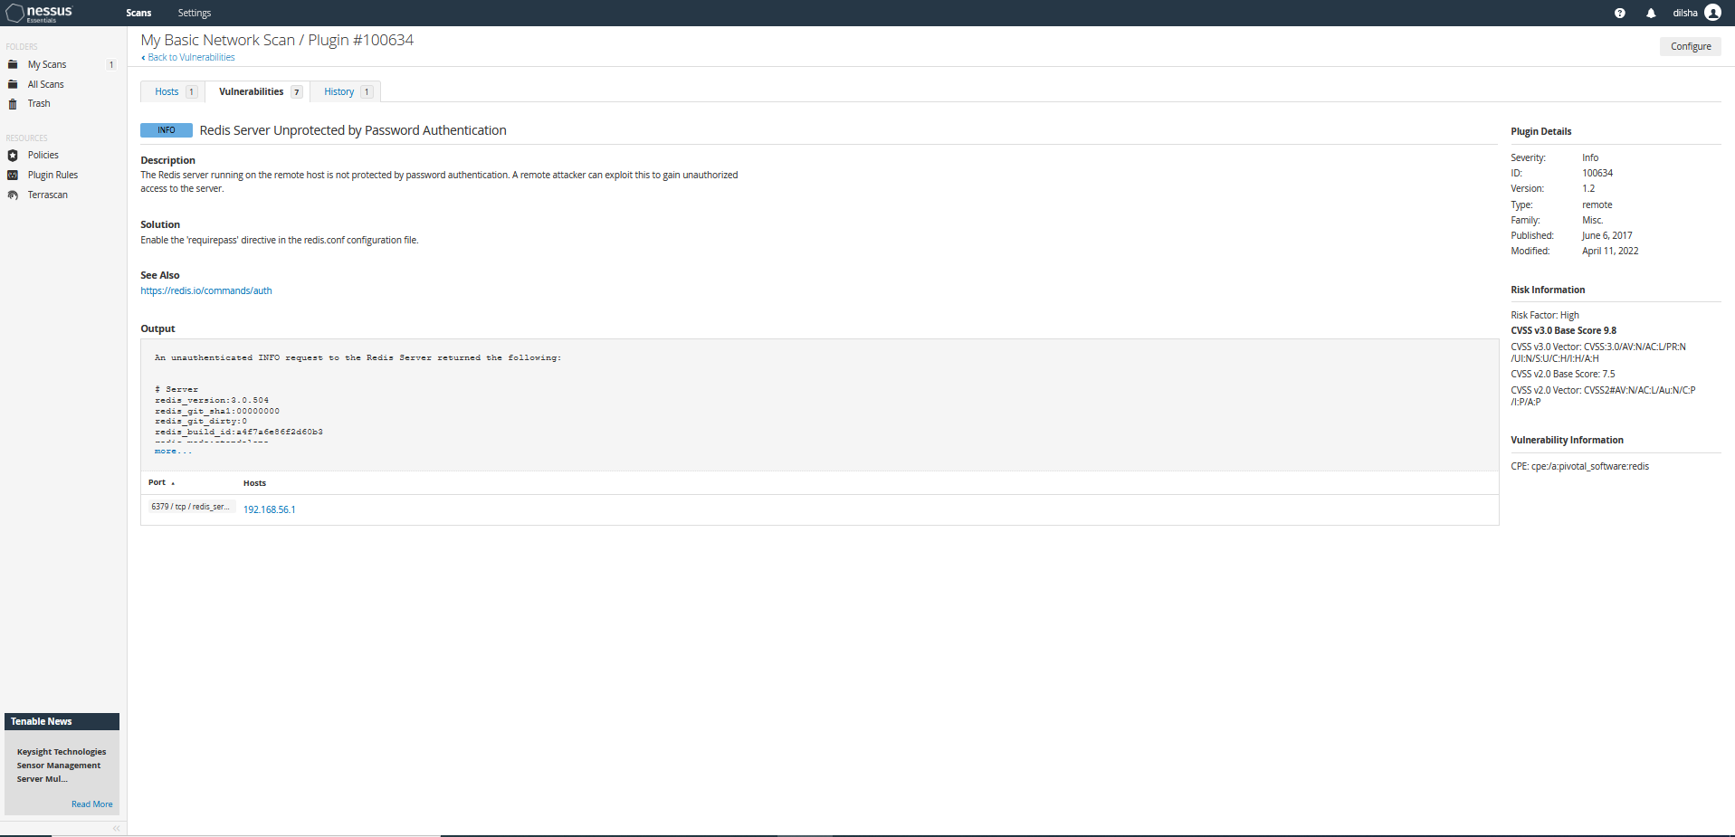

Slide 18
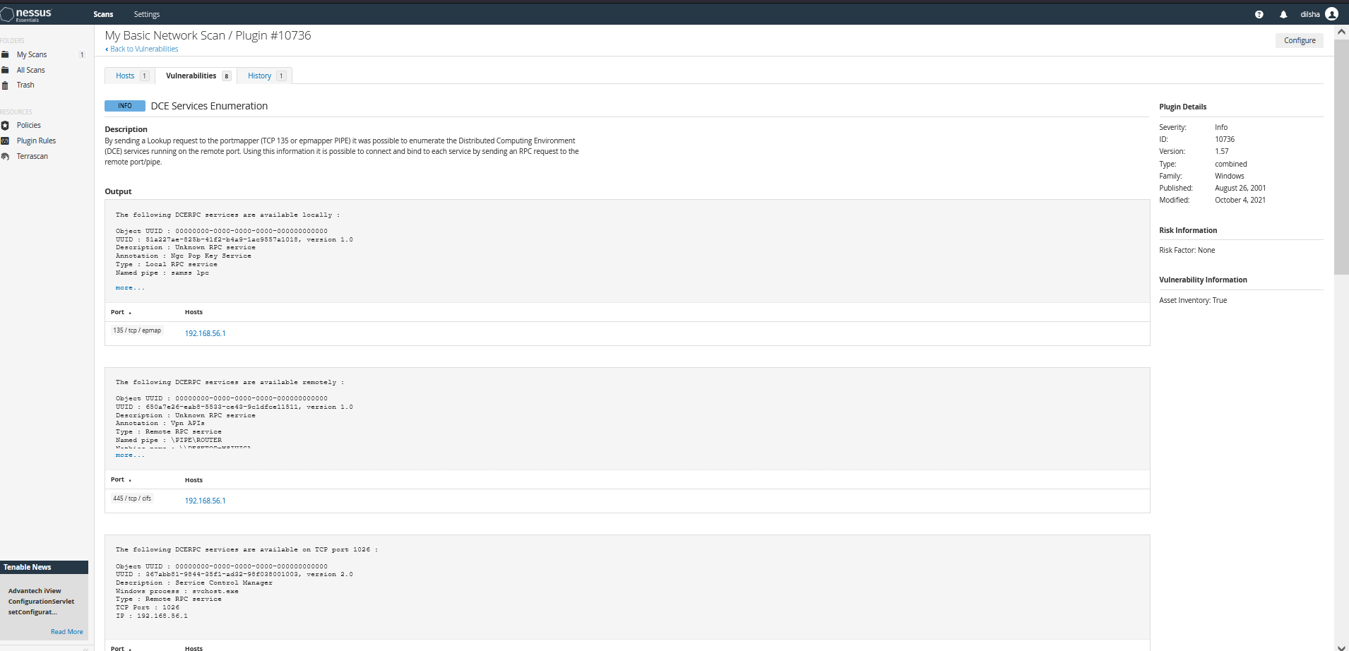

Slide 19
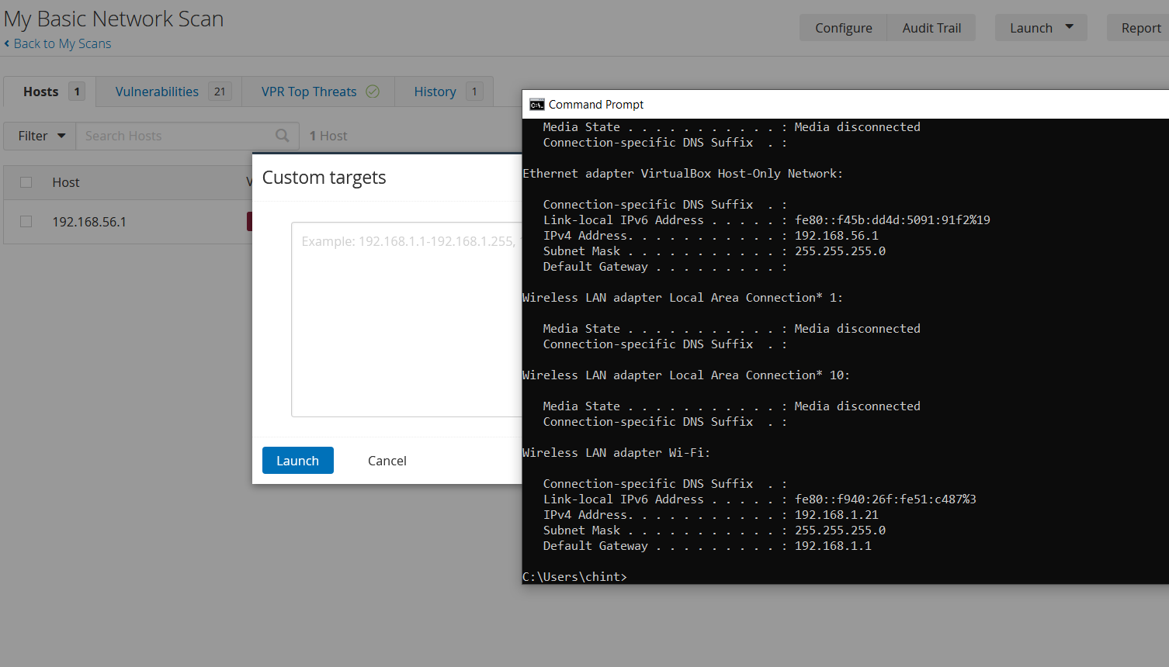
Check vulnerabilities of my router by using Nessus Tool

Slide 20
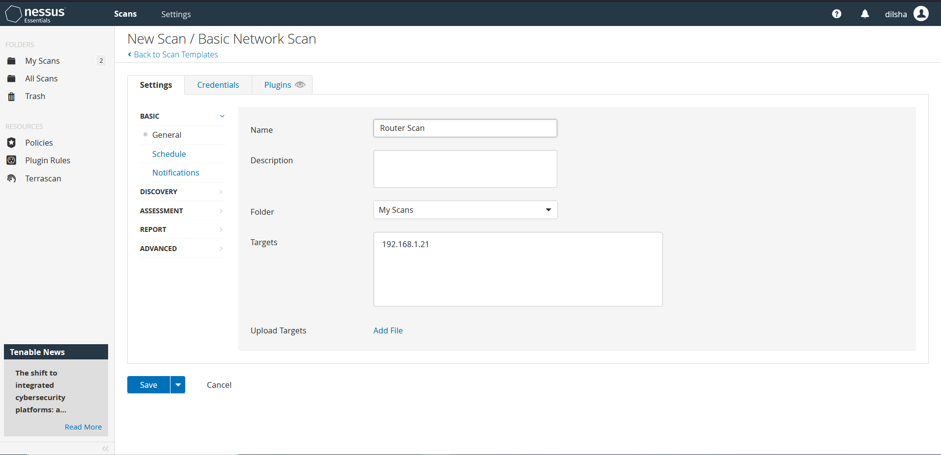

Slide 21
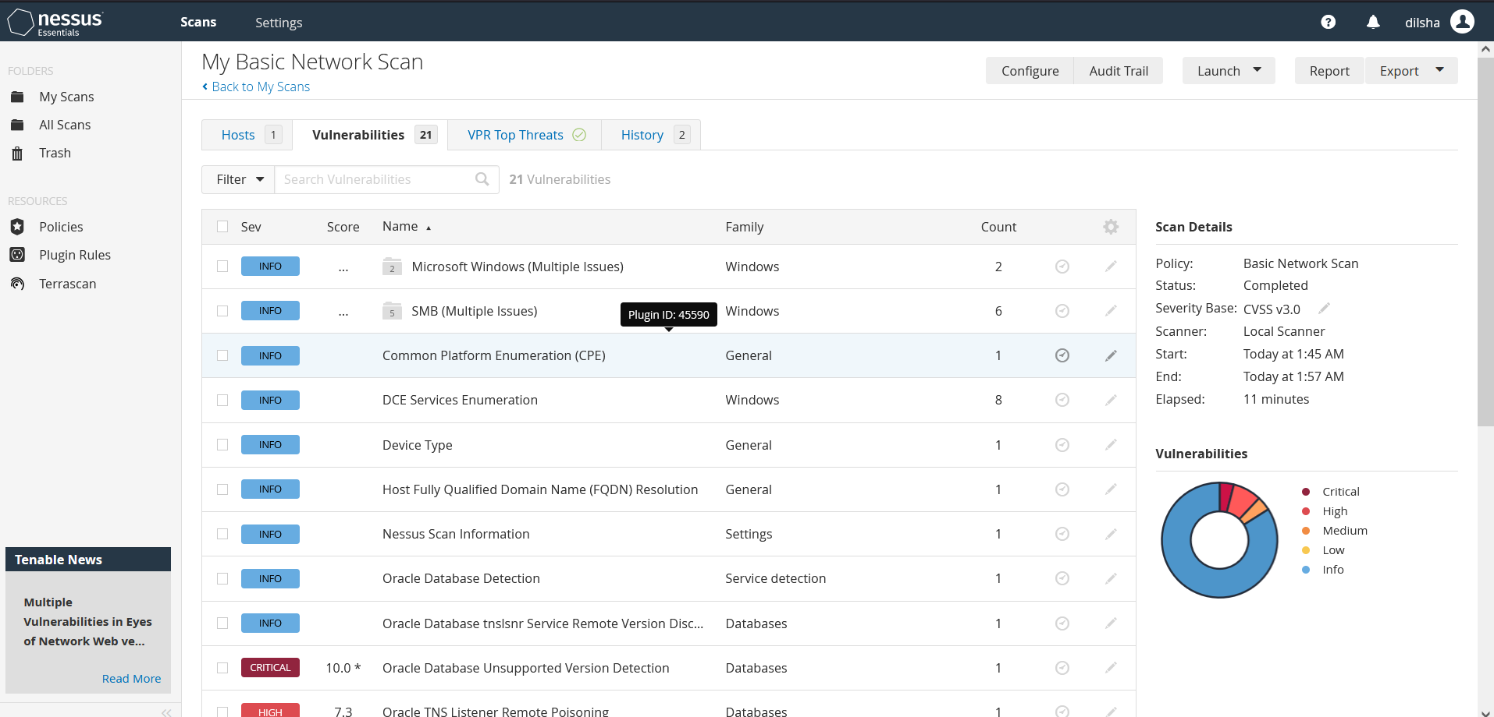

Slide 22
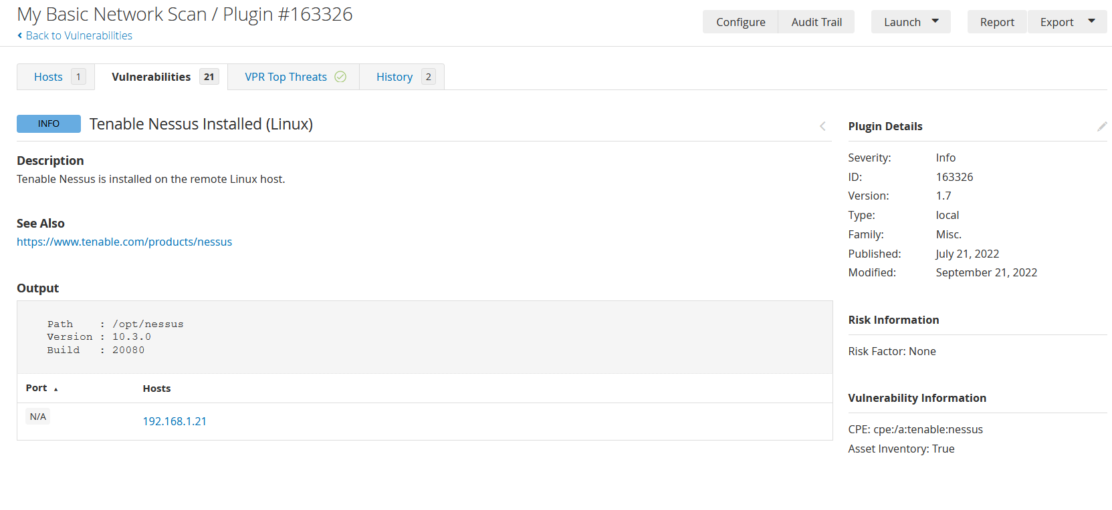

Slide 23
Vulnerabilities revealed by Nessus scan for Metasploitable2
rsh Unauthenticated Access
Proposed fix: Remove the .rhosts files or set a password on the impacted accounts.
Samba Heap-Based Remote Buffer Overflow
Proposed fix: Upgrade to Samba version 3.0.25 or later.
Apache Tomcat Manager Common Administrative Credentials
Proposed fix: Edit the associated “tomcat-users.xml” file and change or remove the affected set of credentials.
vsftpd Smiley Face Backdoor
Proposed fix: Use a legitimate copy of the vsftpd software.
Notes:
rsh Unauthenticated Access
This issue makes it possible for an attacker to log on this machine without a password.
Using common usernames, as well as the usernames reported by “finger,” Nessus could log in through rsh. Either the accounts do not have passwords, or the ~/.rhosts files are not configured correctly.
Samba Heap-Based Remote Buffer Overflow
An attacker can execute arbitrary code on the target system using a vulnerable installation of Samba.
The version of the Samba server installed on the remote host is affected by multiple heap overflow vulnerabilities, which can be exploited remotely to execute code with the privileges of the Samba daemon.
Apache Tomcat Manager Common Administrative Credentials An attacker can use this issue to log into the Apache Tomcat management console using a known set of credentials. An attacker can use this issue to install a malicious application on the affected server and run code with Tomcat’s privileges.
vsftpd Smiley Face Backdoor
An attacker can use this issue to execute arbitrary code on the system using the vulnerable installation of VSFTPD server.
The version of vsftpd running on the remote host has been compiled with a backdoor. An unauthenticated, remote attacker could exploit this to execute arbitrary code as root.

Slide 24
1
Distributed Denial of Service Attack
4
Vulnerabilties
In Routers
Credential Hacking
2
Syn Flood
5
Session Hijacking
3
Brute Force
Notes:
Distributed Denial of Service Attack
As the name suggests, a distributed denial of service attack can use hundreds and potentially thousands of computers to send packets to routers at the same time. The infected computers are referred to as "zombie" hosts. The attacker uses software scripts on each computer’s hard drive to launch the attack. When the attack triggers from the infected computers, they have the ability to target routers and overpower their resources.
Syn Flood
The TCP protocol uses synchronization referred to as TCP/SYN packets for a connection request between computers and servers. When a SYN flood attack occurs, the source computer sends a large number of TCP/SYN packets using a forged address. The destination server on the network is unable to successfully establish a connection to the source due to the address being unreachable. If a router is unable to validate the TCP request, resources can quickly become consumed. This represents a form of denial of service, because the router’s resources can be consumed by the extent of the attack.
Brute Force
Routers can experience a brute force attack when a hacker is attempting to guess the password and gain access. The attacker can use software with a dictionary of words to try and crack the password. Based on the strength of the password and the combinations that are applied to identify a match, the attack could take a short period of time if the password is considerably weak. This type of attack is not limited to a business router; it can also occur whenever a hacker is in range of a home wireless router.
Credential hacking happens when a hacker targets you or your company specifically. They spend a significant amount of time and tech resources on breaking into your accounts by undermining your password defenses. While victims of credential cracking can absolutely be random citizens caught up in a hacker’s trap, the effort behind it often means that the victim was targeted specifically. It might be a business account or a company’s social media accounts, financial accounts, or even the personal finances for someone within a company.
A session hijacking attack happens when an attacker takes over your internet session — for instance, while you're checking your credit card balance, paying your bills, or shopping at an online store. Session hijackers usually target browser or web application sessions. A session hijacking attacker can then do anything you could do on the site.

Slide 25

Recommendations to Manage Vulnerabilities
Disable Remote Access
Use a Network Inspector
Routinely Update the Router Firmware
Set Up a Guest Account
Reset the Router and Passwords
Turn on WiFi network encryption
Turn on your router firewall
Notes:
Most routers have a remote access feature that allows you to access your WiFi network from anywhere you have an internet connection.
Your router’s firmware is an incredibly important piece of the secure network connection puzzle. Most wireless routers don’t auto-update their software, so you must do it manually.
Instead of giving out your wireless credentials to anyone who needs it, let them connect to a guest WiFi network. The guest networking option allows you to set up a separate WiFi network that provides internet access but hides any shared folders, printers, storage devices, and network devices connected to your primary wireless network.
It may be too much of a hassle to turn off your WiFi network every time you walk out the door, but it’s important to disable your home wireless network if you leave for any extended period of time. This will guarantee that your network is completely safe.
Most WPA2 and WPA3 routers offer an encryption option. You can turn on this feature in your router’s WiFi settings, which you can access with your IP address and router login credentials. When you enable encryption for your WiFi network, it encrypts any data sent between your wireless channel and your device.
Router firewalls are often not turned on by default, which means you need to activate yours. To do so, log into your router settings using your IP address to enable the option. You may need to look under your router’s advanced settings to find the firewall toggle.

Slide 26
1
CryptoAPI spoofing vulnerability
4
Vulnerabilties
In Windows
Computers
Microsoft Font Driver Vulnerability
2
Windows RD Gateway Vulnerabilities
5
Win32k Elevation of Privilege Vulnerability
3
Windows Remote Desktop Client Vulnerability
Notes:
CryptoAPI spoofing vulnerability – CVE-2020-0601: This vulnerability affects all machines running 32- or 64-bit Windows 10 operating systems, including Windows Server versions 2016 and 2019. This vulnerability allows Elliptic Curve Cryptography (ECC) certificate validation to bypass the trust store, enabling unwanted or malicious software to masquerade as authentically signed by a trusted or trustworthy organization. This could deceive users or thwart malware detection methods such as antivirus. Additionally, a maliciously crafted certificate could be issued for a hostname that did not authorize it, and a browser that relies on Windows CryptoAPI would not issue a warning, allowing an attacker to decrypt, modify, or inject data on user connections without detection.
Microsoft Font Driver Vulnerability
Windows Adobe Type Manager improperly handles specially-crafted OpenType fonts, which can result in a remote code execution vulnerability. This may lead to attackers gaining complete control of the system to install programs, view/change/delete data, and create new accounts. Though Microsoft has auto-patched this flaw in the wild, the patch can also be manually downloaded and installed.
Win32k Elevation of Privilege Vulnerability
This vulnerability involving a flaw in a GUI component of Windows 10—namely the scrollbar element—allows a threat actor to gain complete control of a Windows machine through privilege escalation. Microsoft has made a patch available for fixing this flaw.

Slide 27
Recommendations to Manage Vulnerabilities
Update OS systems using the most recent Microsoft patch level.
Install the most recent virus definitions in your anti-virus programs.
Always keep an eye out for any potentially dangerous activity using your EDR and anti-malware tools and solutions.
Turn on the Firewall.
Notes:
Utilize the most recent Microsoft patch level to update OS systems.Update your anti-virus applications with the latest updated virus definitions.Use your EDR and anti-malware tools and solutions to always keep a look out for any potentially hazardous activities.activate the Firewall.

Slide 28
1
Binary Protection
4
Vulnerabilties
In Android Mobile
Devices
Certifi-Gate Vulnerability
2
QuadRoot vulnerability
5
Vulnerabilities installed by OEMs
3
HummingBad
Notes:
Binary Protection
Not rooting a device properly can expose it to severe attacks. Like you may already know, rooting an Android device bridges the data protection and encryption. Once an Android device gets compromised through root, certainly, any code can run on the device including malicious codes. Hence, it is a bit easier for a hacker to gain access to the device.
QuadRoot vulnerability
This is a recent attack on mobile devices powered by Qualcomm’s chipsets. Experienced hackers can possibly gain full access and control over your Android device and personal data using this vulnerability. The latest update from ZoneAlarm shows there are about 4 QuadRoot vulnerabilities.
HummingBad
This is a virus developed by Yingmob, a Chinese advert company. So far according to reports this virus has affected more than 10 million Android devices. HummingBad is a malware that creates false ad revenue and automatically installs more malicious apps on Android. The HummingBad malware has root access on Android, so, attackers can virtually do anything they like on affected devices.
Certifi-Gate Vulnerability
Mobile Remote Support Tools (mRSTs), which are frequently pre-installed on Android devices, have certificate verification flaws, according to security research. These malicious apps could seem legitimate at first glance since they only ask for a small number of permissions, but they use the mRST vulnerability to connect to your device and access it.Certifi-Gate is a difficult vulnerability that exposes your personal information and enables attackers to take complete control of your Android device.
Vulnerabilities installed by OEMs
It goes without saying that hackers might take advantage of these vulnerabilities that were pre-installed to perform a variety of operations on the impacted device or even steal their private information by tricking a victim into installing a malicious app.Because each Android phone comes with a different set of pre-installed apps, each one has a different set of vulnerabilities. Google also finds it challenging to keep track of all the pre-installed apps due to the enormous variety of Android phone manufacturers. Some manufacturers, meanwhile, do a decent job of solely pre-installing protected apps.

Slide 29
Recommendations to Manage Vulnerabilities
Binary Protection – Keep a close eye on the applications you install on your Android device, especially if it has been rooted. Some root apps copy your device's data covertly and make it available to a third party.
QuadRoot vulnerability – Update the mobile OS
HummingBad - Run a factory reset on your device, then use your computer to reset your Google password so you may use fresh login information to activate your Android.
Certifi-Gate Vulnerability - Ask your manufacturer for an OS upgrade and remove all suspicious applications from your device.
Vulnerabilities installed by OEMs - Before purchasing a product from an unknown vendor, always check reviews on reputable tech review sites.
Notes:
Binary Protection: If your Android smartphone has been rooted, pay great attention to the programs you install. Some root programs secretly transfer the data on your smartphone and make it accessible to a third party.Update the mobile OS to address the QuadRoot vulnerability.HummingBad: Perform a factory reset on your device, then use your computer to change your Google password so that you may activate your Android with new login credentials.Certifi-Gate Vulnerability - Request an OS upgrade from your manufacturer and uninstall any suspicious apps on your device.Vulnerabilities put in place by OEMs - Always read reviews on reliable tech review websites before buying a product from an unidentified source.

Slide 30

Implementation of Top 10 Controls

Slide 31
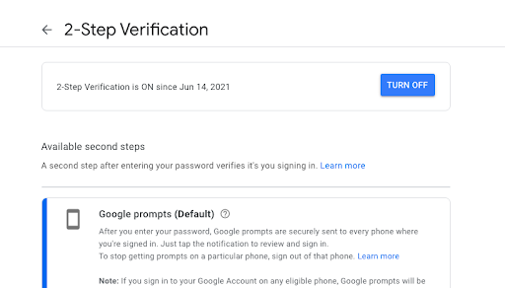
Apply two-factor authentication.
Notes:
The most common way to sign into a system was with simply the username and password. But 2 factor authentication was established because getting usernames and passwords has gotten a lot simpler. This requires an additional method of identity verification upon sign-in. Typically, a passcode or an SMS were used. Due to the capability of attackers, multi factor authentication was implemented since even two factors are insufficient. More than two methods must be used to confirm that the sign-in attempt is coming from the intended party.

Slide 32
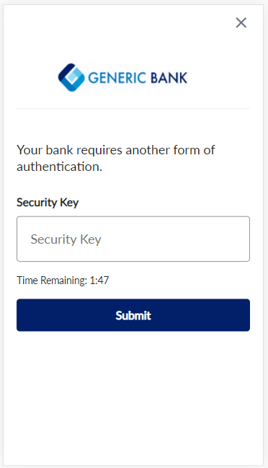
Open bank account that supports MFA.
Notes:
Implementing MFA in banking sector provides the following benefits.
It provides more layers of security than 2FA. ...
It assures consumer identity. ...
It meets regulatory compliances. ...
It comes with easy implementation. ...
It complies with Single Sign-On (SSO) solutions. ...
It adds next-level security, even remotely. ...
It is an effective cybersecurity solution.

Slide 33
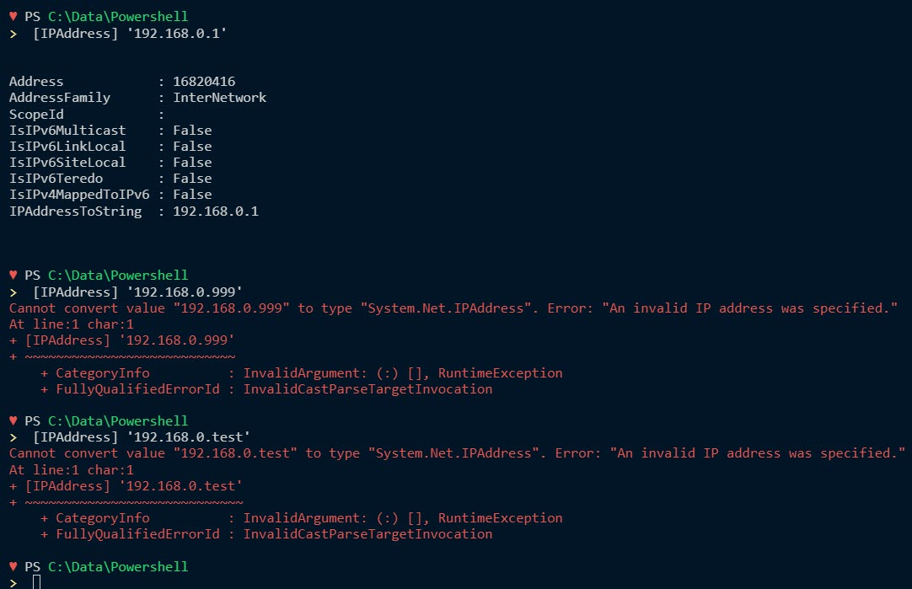
Develop a PowerShell script to check the unauthorized access by unsafe IP entrees.
Notes:
Develop a PowerShell script to check the unauthorized access by unsafe IP entrees. Script will detect the unsafe IP entrees to the mobile ISP

Slide 34
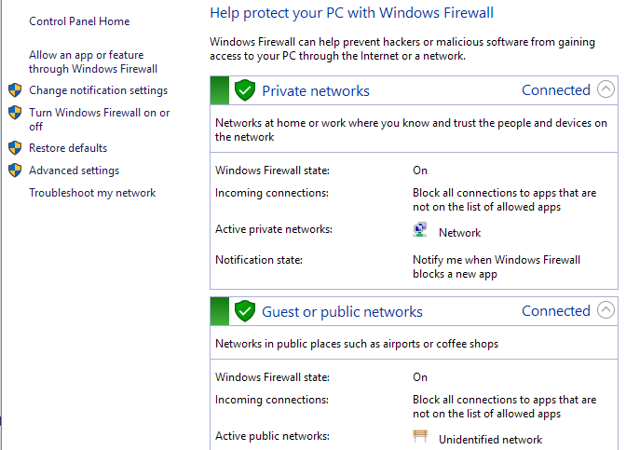
Adding strong physical firewall that supports to filter networks
Notes:
The first line of protection against external threats, viruses, and hackers seeking to access your data and systems is a firewall. Firewalls use pre-made rules and filters by monitoring and analyzing network traffic to keep your systems safe. Firewalls are becoming even more crucial as data theft and hostage-taking by criminals have increased since they stop hackers from accessing your data, emails, systems, and other things without your permission.

Slide 35
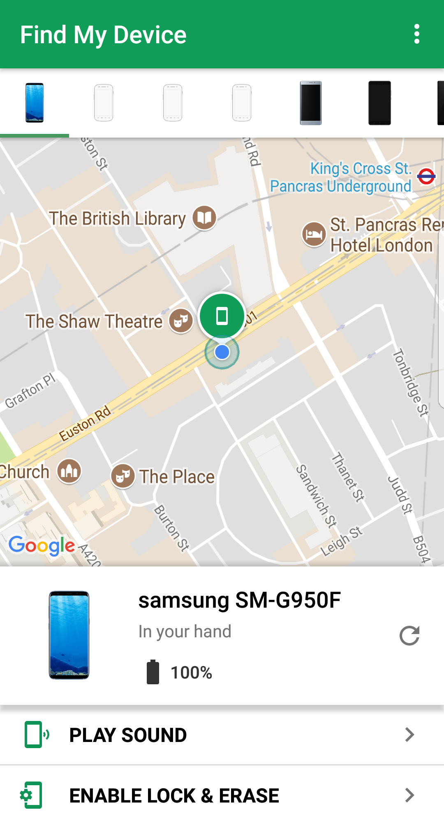
Apply a phone locator
Notes:
If you have logged into a Google Account, you might be able to locate, lock, or wipe your phone remotely if you lose it. Mobile devices linked to a Google Account have Find My Device turned on by default.

Slide 36
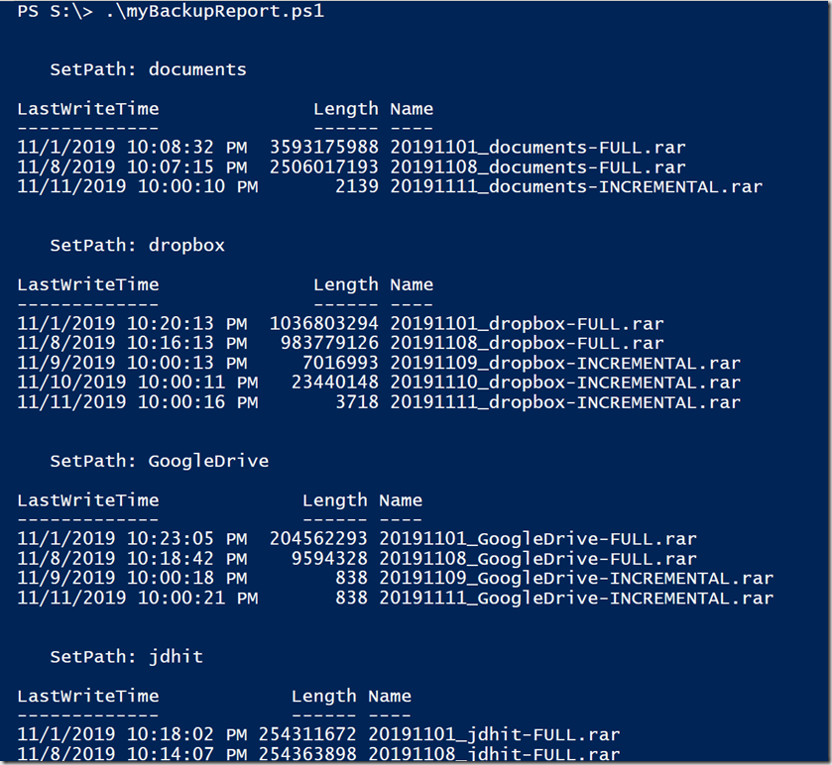
Develop a PowerShell script to check the integrity of backup files.
Notes:
The Backup Integrity Check ensures proper operation of backup tasks and the consistency between the backup data and source files until the complete restoration of backup data.

Slide 37
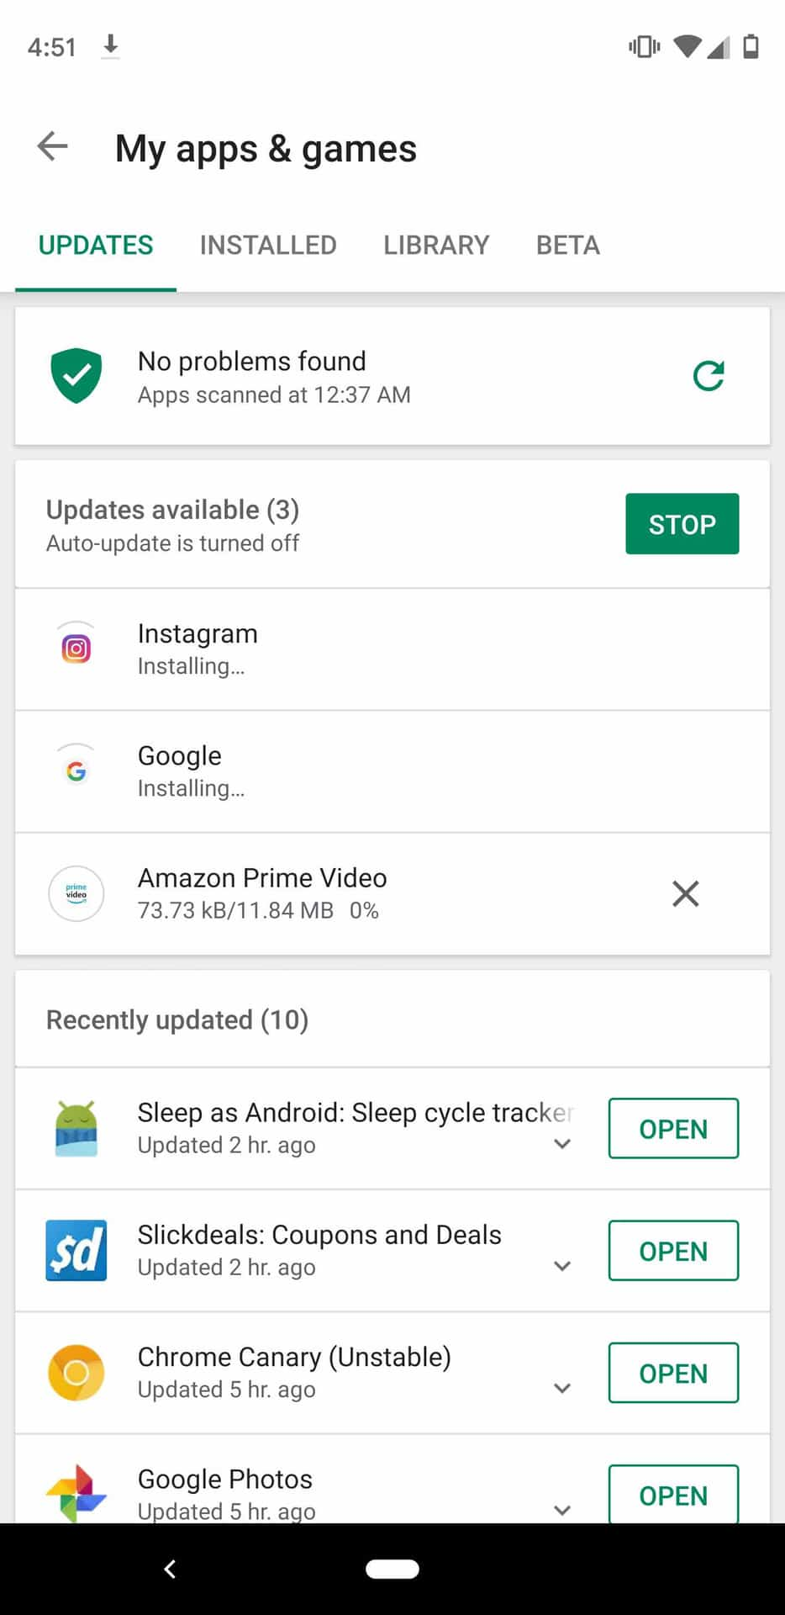
Keeping the software to up-to-date and keep the device with secured apps from google or phone store
Notes:
Old and outdated software is vulnerable to hackers and cyber criminals as updates keep you safe from exploitable holes into your devices. Software updates provide more than just security updates, they often offer new and improved features and speed enhancements to make the end-user experience better.

Slide 38
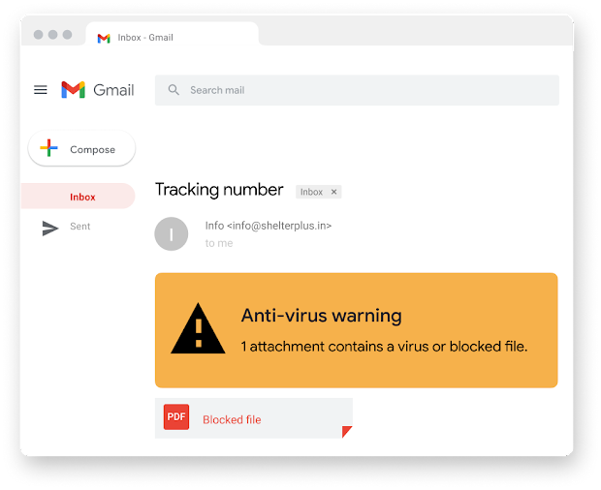
Apply google security protector
Notes:
Apply google security protector which Can filter unwanted emails as spam and give more priority for safe emails

Slide 39
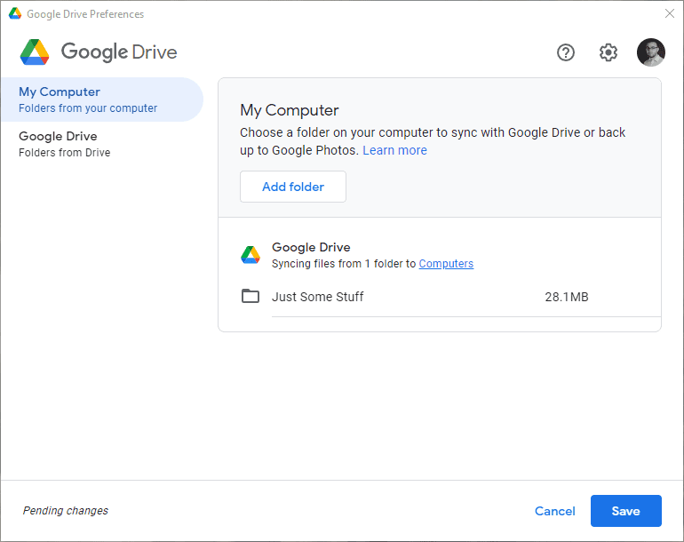
Keep the google drive up-to-date to avoid the data loss
Notes:
Google offers backup options for your data in its secure data centers, spread out across multiple locations worldwide. The ability to access your stored data anytime, anywhere, and from any device with an internet connection is the main advantage of Google Drive backups.

Slide 40
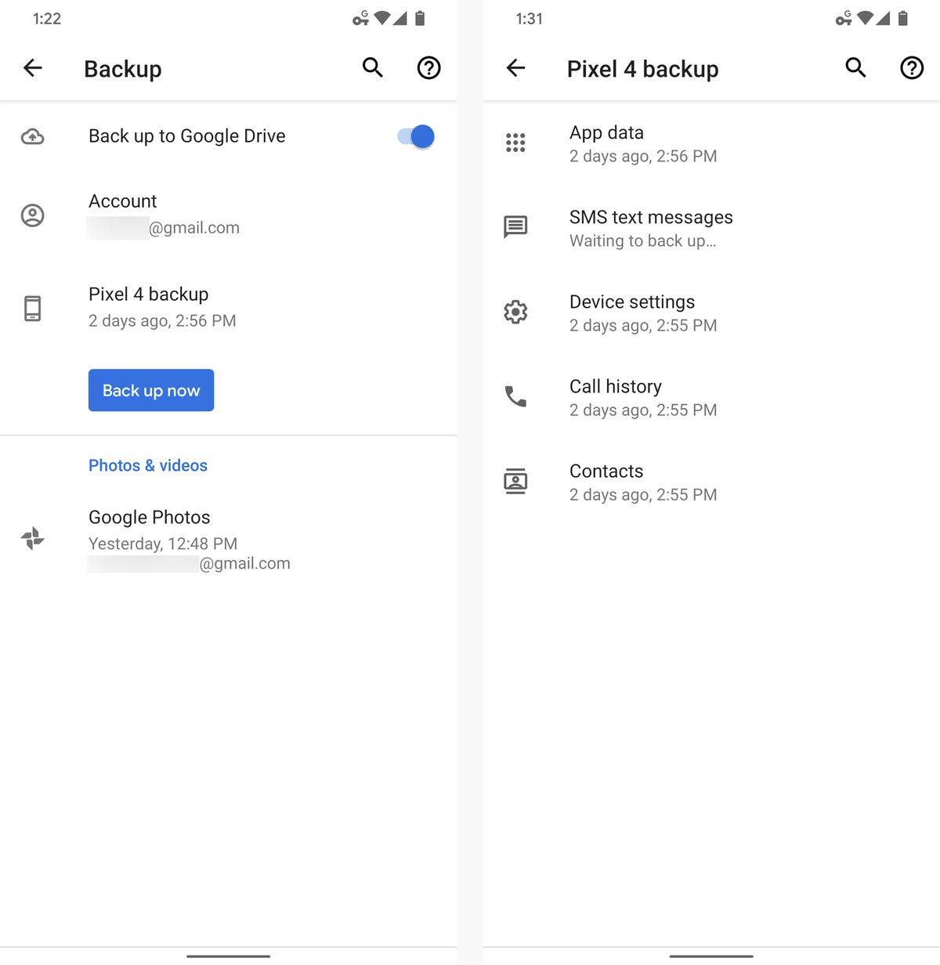
Link the backup device with google drive to store important backup data
Notes:
Data needs to be stored for future use and applications and files.
Link the backup device with google drive to store important backup data.
Duplicate files in both device and drive for a data safe and make sure it updated up-to-date.

Slide 41
References
Horowitz, D. (2021, August 25). 10 best ways to protect your home network security: HP® Tech takes. 10 Best Ways To Protect Your Home Network Security | HP® Tech Takes. Retrieved September 28, 2022, from https://www.hp.com/us-en/shop/tech-takes/best-ways-to-protect-home-network-security
How to fix the top 10 Windows 10 vulnerabilities [infographic]: Upguard. RSS. (n.d.). Retrieved September 28, 2022, from https://www.upguard.com/blog/top-10-windows-10-security-vulnerabilities-and-how-to-fix-them
Tech2020. (2021, January 18). What is nessus and how does it work? - ITPERFECTION - network security. ITperfection. Retrieved September 28, 2022, from https://www.itperfection.com/network-security/network-monitoring/what-is-nessus-and-how-does-it-work-network-munitoring-vulnerabilit-scaning-security-data-windows-unix-linux/
Casey, K. (2021, October 22). Top 7 vulnerabilities in Android Applications 2022. CODERSERA. Retrieved September 28, 2022, from https://codersera.com/blog/top-7-vulnerabilities-in-android-applications-2019/
Analysis on security vulnerabilities of routers. Huawei. (n.d.). Retrieved September 28, 2022, from https://support.huawei.com/enterprise/en/doc/EDOC1100125841/f4f8c921/analysis-on-security-vulnerabilities-of-routers

Slide 42
Thank You!

